Slide 1
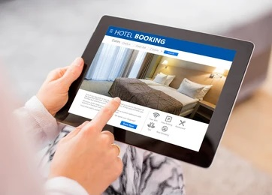
Capstone Project
Hotel Booking Analysis
Submitted By:
Yusuf Khan
Sameer Awasthi

Slide 2
Points for Discussion
Data Summary & Necessary Steps(Data Wrangling)
Data Analysis
Analysis # 1: Status of Reservation and the Repeated Guest
Analysis # 2: Country Name from where most of the Guests are coming
Analysis # 3: Month Wise Bookings
Analysis # 4: Bookings by Various Sources
Analysis # 5: Monthly Cancellations
Analysis # 6: Cancellations by Type of Customer
Analysis # 7: Duration of Stay of People
Analysis # 8: Comparison of Duration of Stay in both types of Hotel
Analysis # 9: Most Booked Accommodation Type
Analysis # 10: Booking Ratio of Type of Hotel

Slide 3
Data Summary
This data set contains booking information for a city hotel and a resort hotel, and includes information such as when the booking was made, length of stay, the number of adults, children and the number of available parking spaces, among other things.
Following steps were taken to start the Analysis of the Data.
Data Cleaning: Checking for missing or null values in any of the columns.
Separating and generating distinct datasets for the two categories of hotels. (i.e., Resort and City Hotel)
Analysis

Slide 4
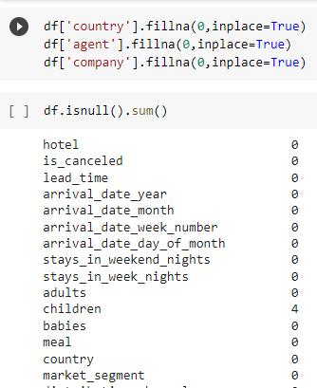
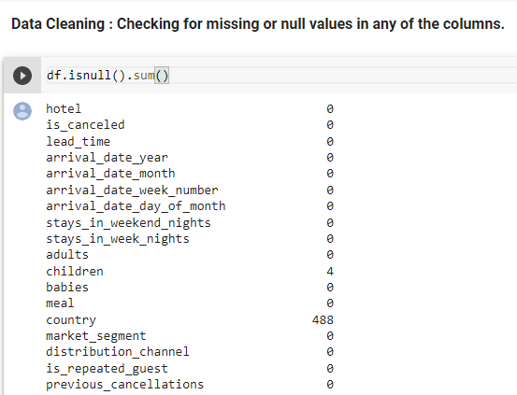
Data Wrangling
Data Cleaning:
The data cleaning process consist of checking for missing or null values in any of the columns.
Replaced those null values with zero.

Slide 5
Data Analysis
Motivation behind this project is to give the answer of following questions:
How many bookings were cancelled?
From which country most of the guest comes?
which is the busiest month of hotel?
which platform customer use to book a ticket. ie. source of booking.
Monthly cancelation of ticket.
Which type of customer cancel their ticket.
how long people stay in the hotel.
Ratio of booking of Both type of Hotels.

Slide 6
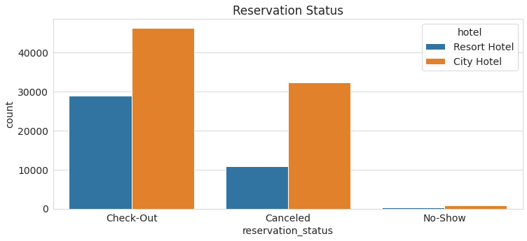
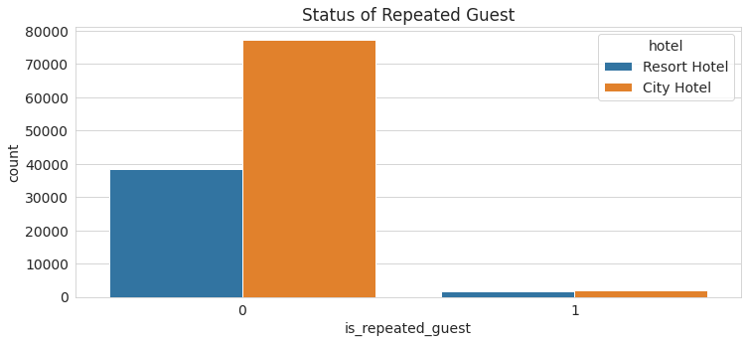
Analysis # 1: Status of Reservation and the Repeated Guest
It helps the company to get the detail about the Check-out and Cancel Reservation Status.

Slide 7
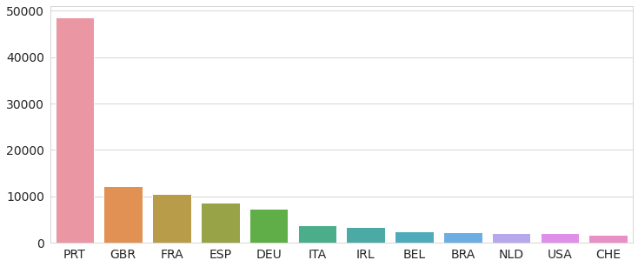
Analysis # 2: Country Name from where most of the Guests are coming
This Analysis helps company to make a custom or attractive packages for the country from where less guests are coming.

Slide 8
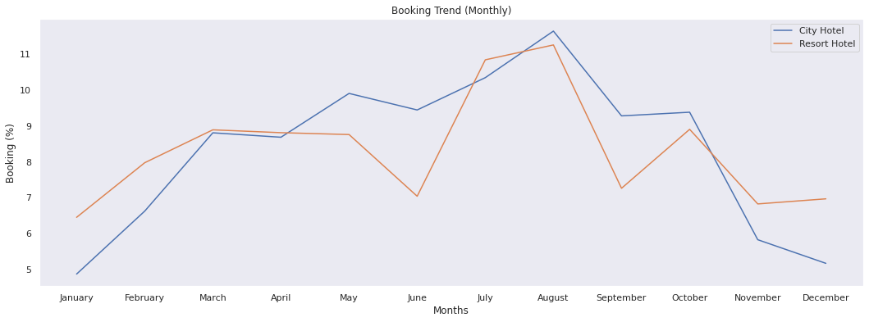
Analysis # 3: Month Wise Bookings
By this Analysis Company can figure Out which month have less no. of bookings, and provide some offers in that months to increase the sales.

Slide 9
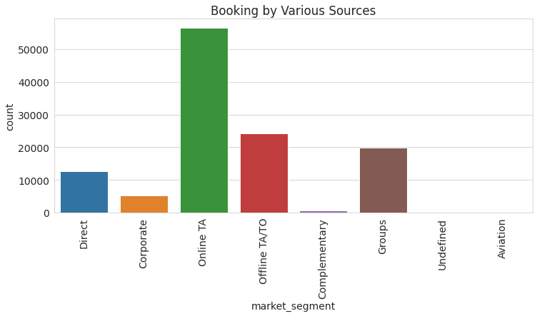
Analysis # 4: Bookings by Various Sources
By this, Company can get the sources of Booking and get the Idea on which platfom they have to focus.

Slide 10
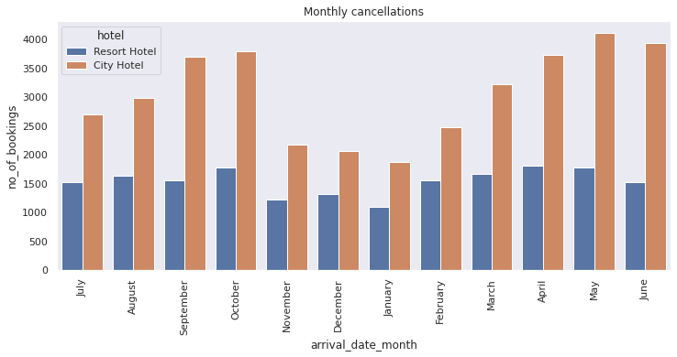
Analysis # 5: Monthly Cancellations
By this Analysis Company can figure Out which month have max. number of cancellations so that they can have the Idea of Reason for Cancellation like month containing less holidays etc.

Slide 11
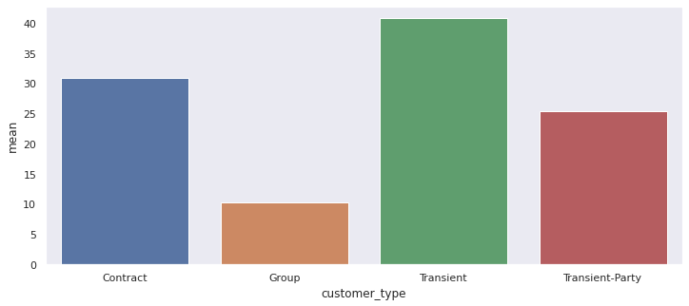
Analysis # 6: Cancellations by Type of Customer
By this Insight, Company can easily focus on the type of Customers who cancel their Visit / Stay

Slide 12
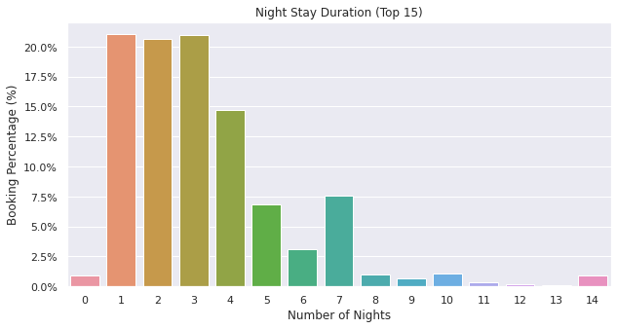
Analysis # 7: Duration of Stay of People
This is just for Information of the Duration of Stay

Slide 13
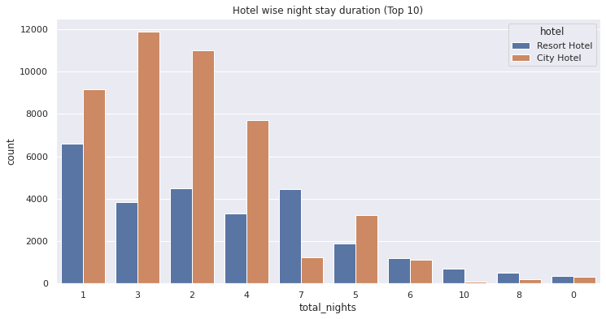
Analysis # 8: Comparison of Duration of Stay in both types of Hotel
This Analysis provide the comparison by which company get to know that in which type of hotel, people like to stay more.

Slide 14
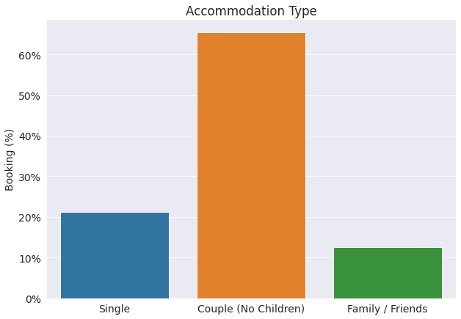
Analysis # 9: Most Booked Accommodation Type
By this Analysis, company get to know, which accommodation type is highly booked, so that company can increase or decrease the types of accommodation in their property accordingly.

Slide 15
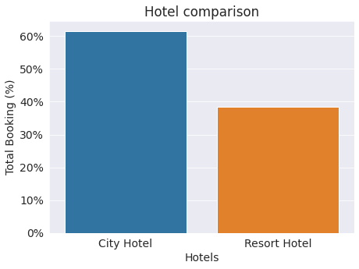
Analysis # 10: Booking Ratio of Type of Hotel
Finally, by this analysis, company get the Ratio of booking of Both type of Hotels.

Slide 16
Conclusion
Resort hotel cancelation rate is low( approx 30%).Most of the time booking not cancelled.
Most of the population booked the city hotel, also the percentage of repeated guest is high in City hotel.
Portugal, GBR and FRA are the top countries from where most of the guest comes.
Most bookings were made from July to August. And the least bookings were made at the start and end of the year.
Guest uses different channel for making booking, out of which most preferred way were online through TA( Travel Agent).
Both the Hotels can figure Out which month have max. number of cancellations so that they can have the Idea of Reason for Cancellation like month containing less holidays etc.
monthly cancelation Analysis can figure Out which month have max. number of cancellations so that they can have the Idea of Reason for Cancellation like month containing less holidays etc.
Both the hotel can easily focus on the type of Customers who cancel their Visit / Stay.

Slide 17
Conclusion Cont..
Both the Hotel Information of the Duration of Stay is available.
After comparison of duration of stay in both hotel it is easily get to know that in which type of hotel, people like to stay more.
Most booked accommodation type can increase or decrease the types of accommodation in their property accordingly.
Booking ratio gives the ration of booking of both type of hotel.

Slide 18
References
https://medium.com/
https://www.geeksforgeeks.org/
https://www.researchgate.net
https://www.kaggle.com/
https://jovian.ai/

Slide 19
THANK YOU

